Slide 1

ADM SIT - AUTOMATION

Slide 2
3 domains
ASF
RI
GAO
Workflows automatized with CTD and Selenium:
Refonte Regliss: 4 functionalities covered (30% of the application) –v4
Aurora: 3 functionalities covered (25% of the application) - just for demonstration
MIRO: 2 functionalities covered (15% of the application) – just for demonstration
SHARE – automation in progress, CTD and Selenium for all screens and main workflows
IH: 7 functionalities covered(80% of the application) –iteration 12
5 applications
ORC – IH
Refonte Regliss
Aurora
MIRO
Share

Slide 3

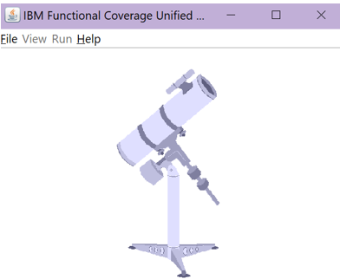
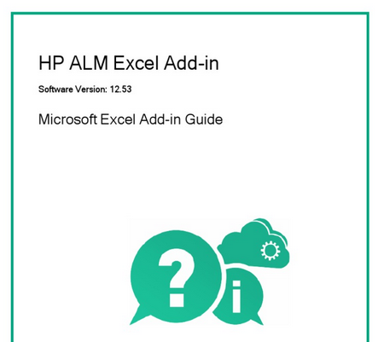













Tools used by the testing team

Slide 4

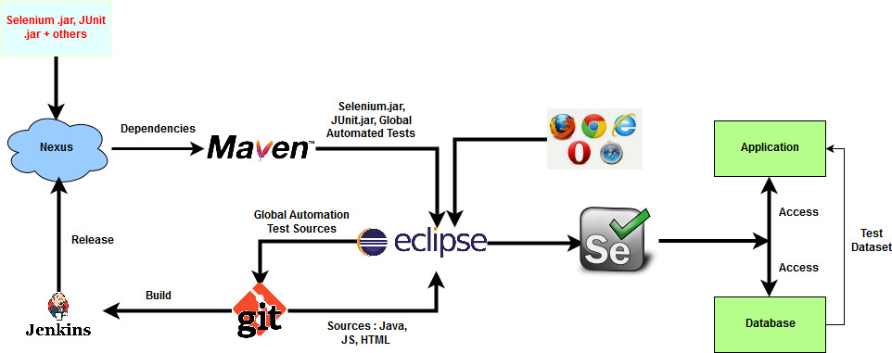
Prerequisites: tools used/needed
CTD FOCUS
Generated
TNR

Slide 5
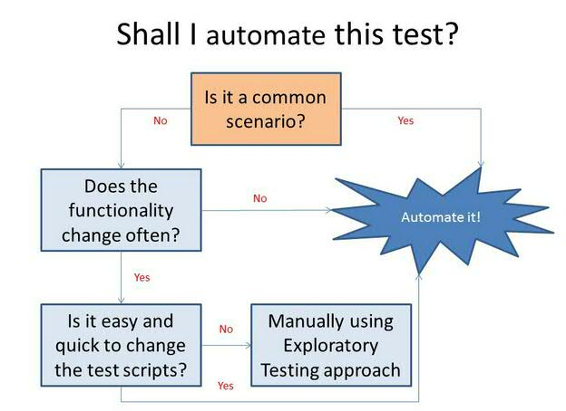
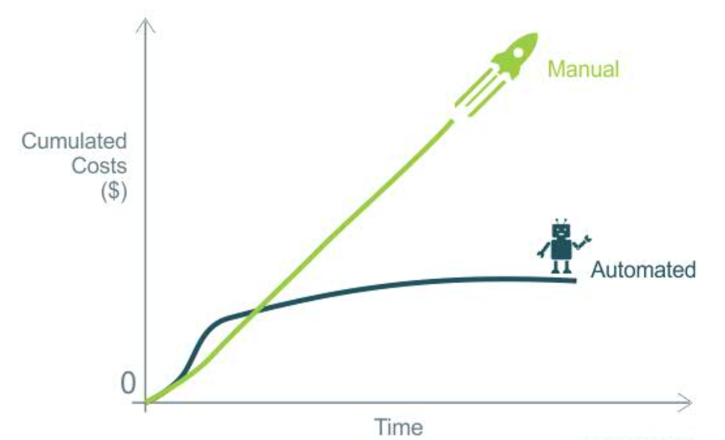

Why automation?
Long-term investment that saves time and money, that increases test coverage, speed, efficiency and quality
Scripts reusability: it allows you to redo the test exactly the same, without forgetting any steps
Fewer bugs: Automation helps you find bugs in the early stages of software development, reducing expenses and working hours to fix these problems as well.
Simultaneity: you can test more devices simultaneously resulting in comparative detailed reports generated in less time with the exact the same parameters

Slide 6
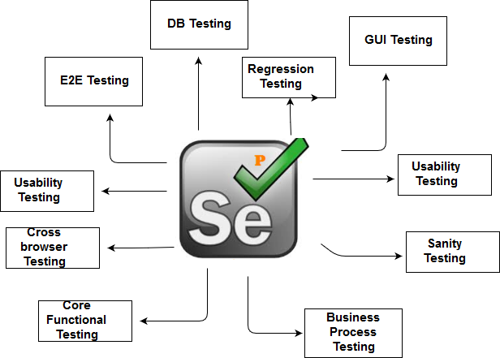
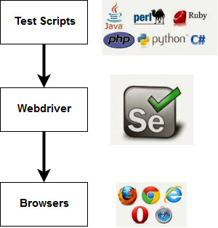
Why SELENIUM?
open source testing tool which serves for cost-effective automation testing
it operates on almost every OS
It supports a range of browsers like Opera, Safari, Chrome, IE 8, 9, 11 and Mozilla Firefox
It provides support for integration of open source frameworks like TestNG, JUnit, NUnit

Slide 7

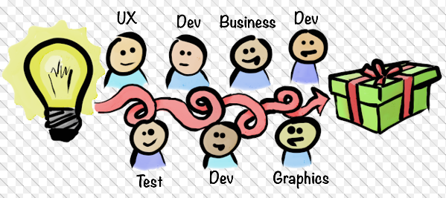
Combinatorial Test Design (CTD)

Slide 8
CTD Overview
What is
Combinatorial Test Design (CTD)?
A systematic method of planning the functional tests
A smarter way to identify the tests
It uses advanced mathematical algorithms to optimize the number of test cases and to ensure the coverage of the conditions and interactions
OPTIMIZATION
To minimize the risks, changes in the testing approach are required
To achieve the quality objectives
To reduce the number of test cases and to increase the coverage
Why
Combinatorial Test Design (CTD)?
Value Proposition
improving the quality, optimizing the effort and reducing the testing time
Reducing the cost of testing projects and the running cost by up to 40%
Reducing the testing time due to an optimized number of test cases
Improved quality through a higher degree of the test coverage

Slide 9
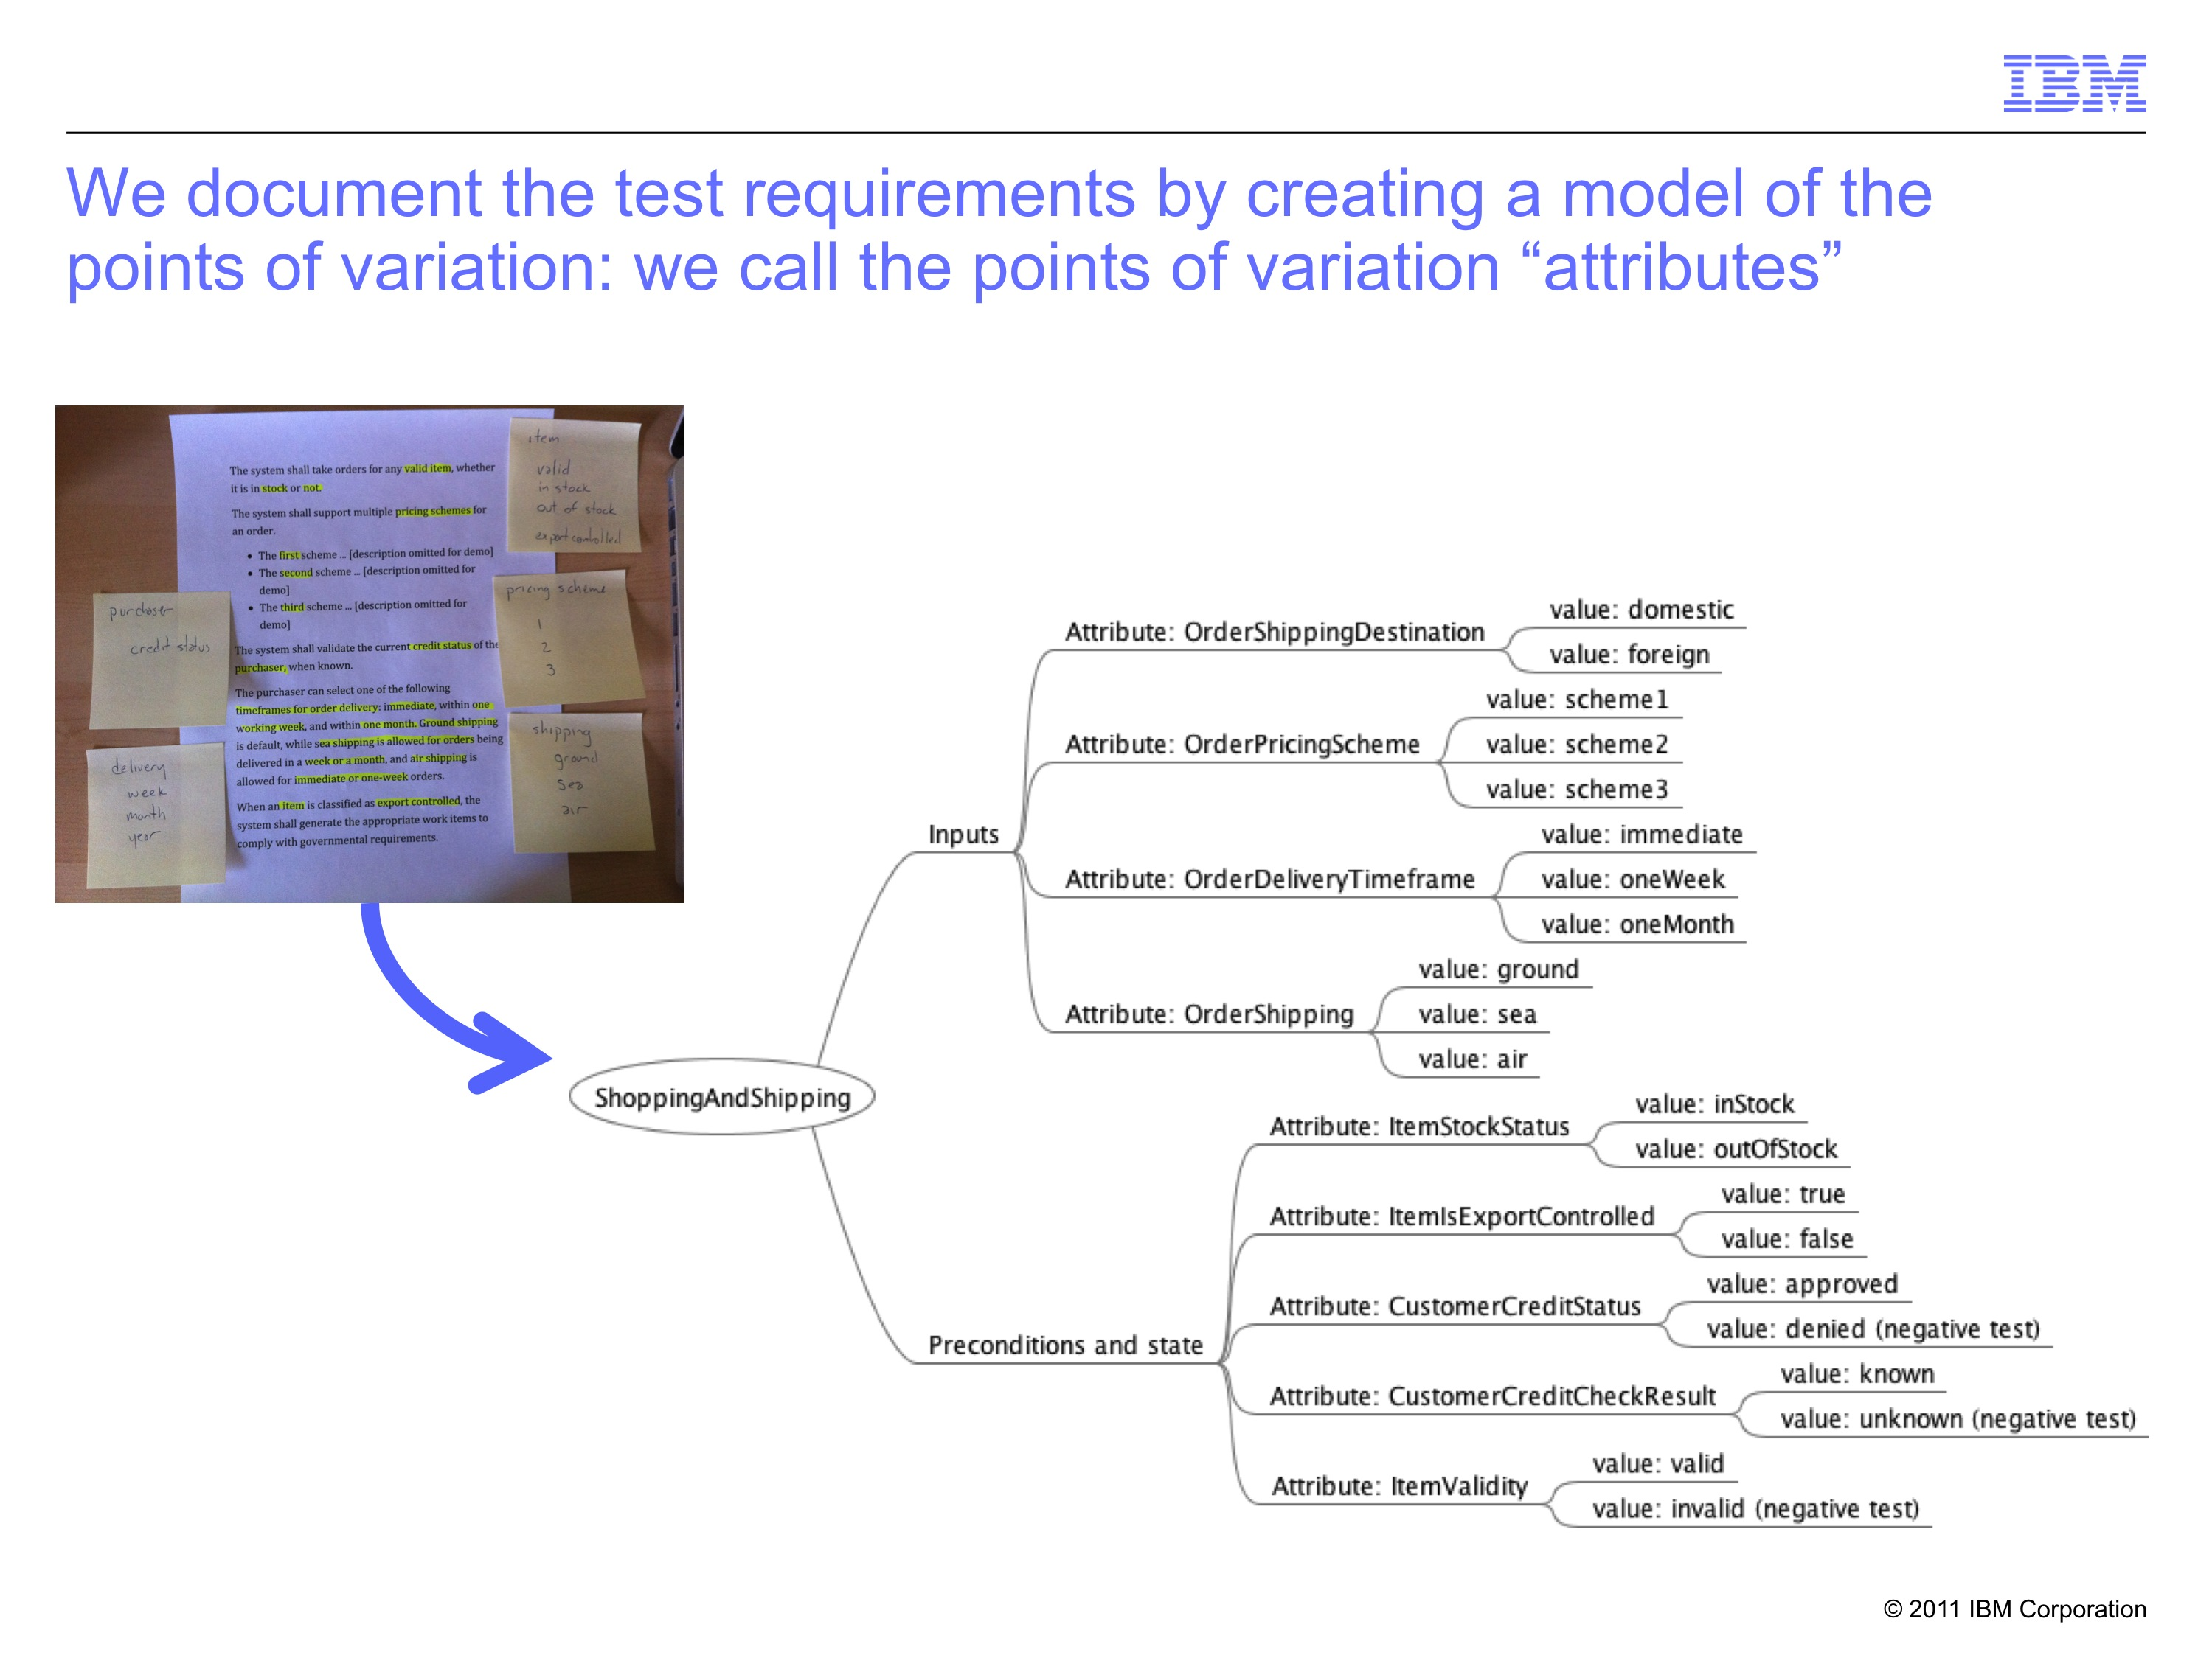
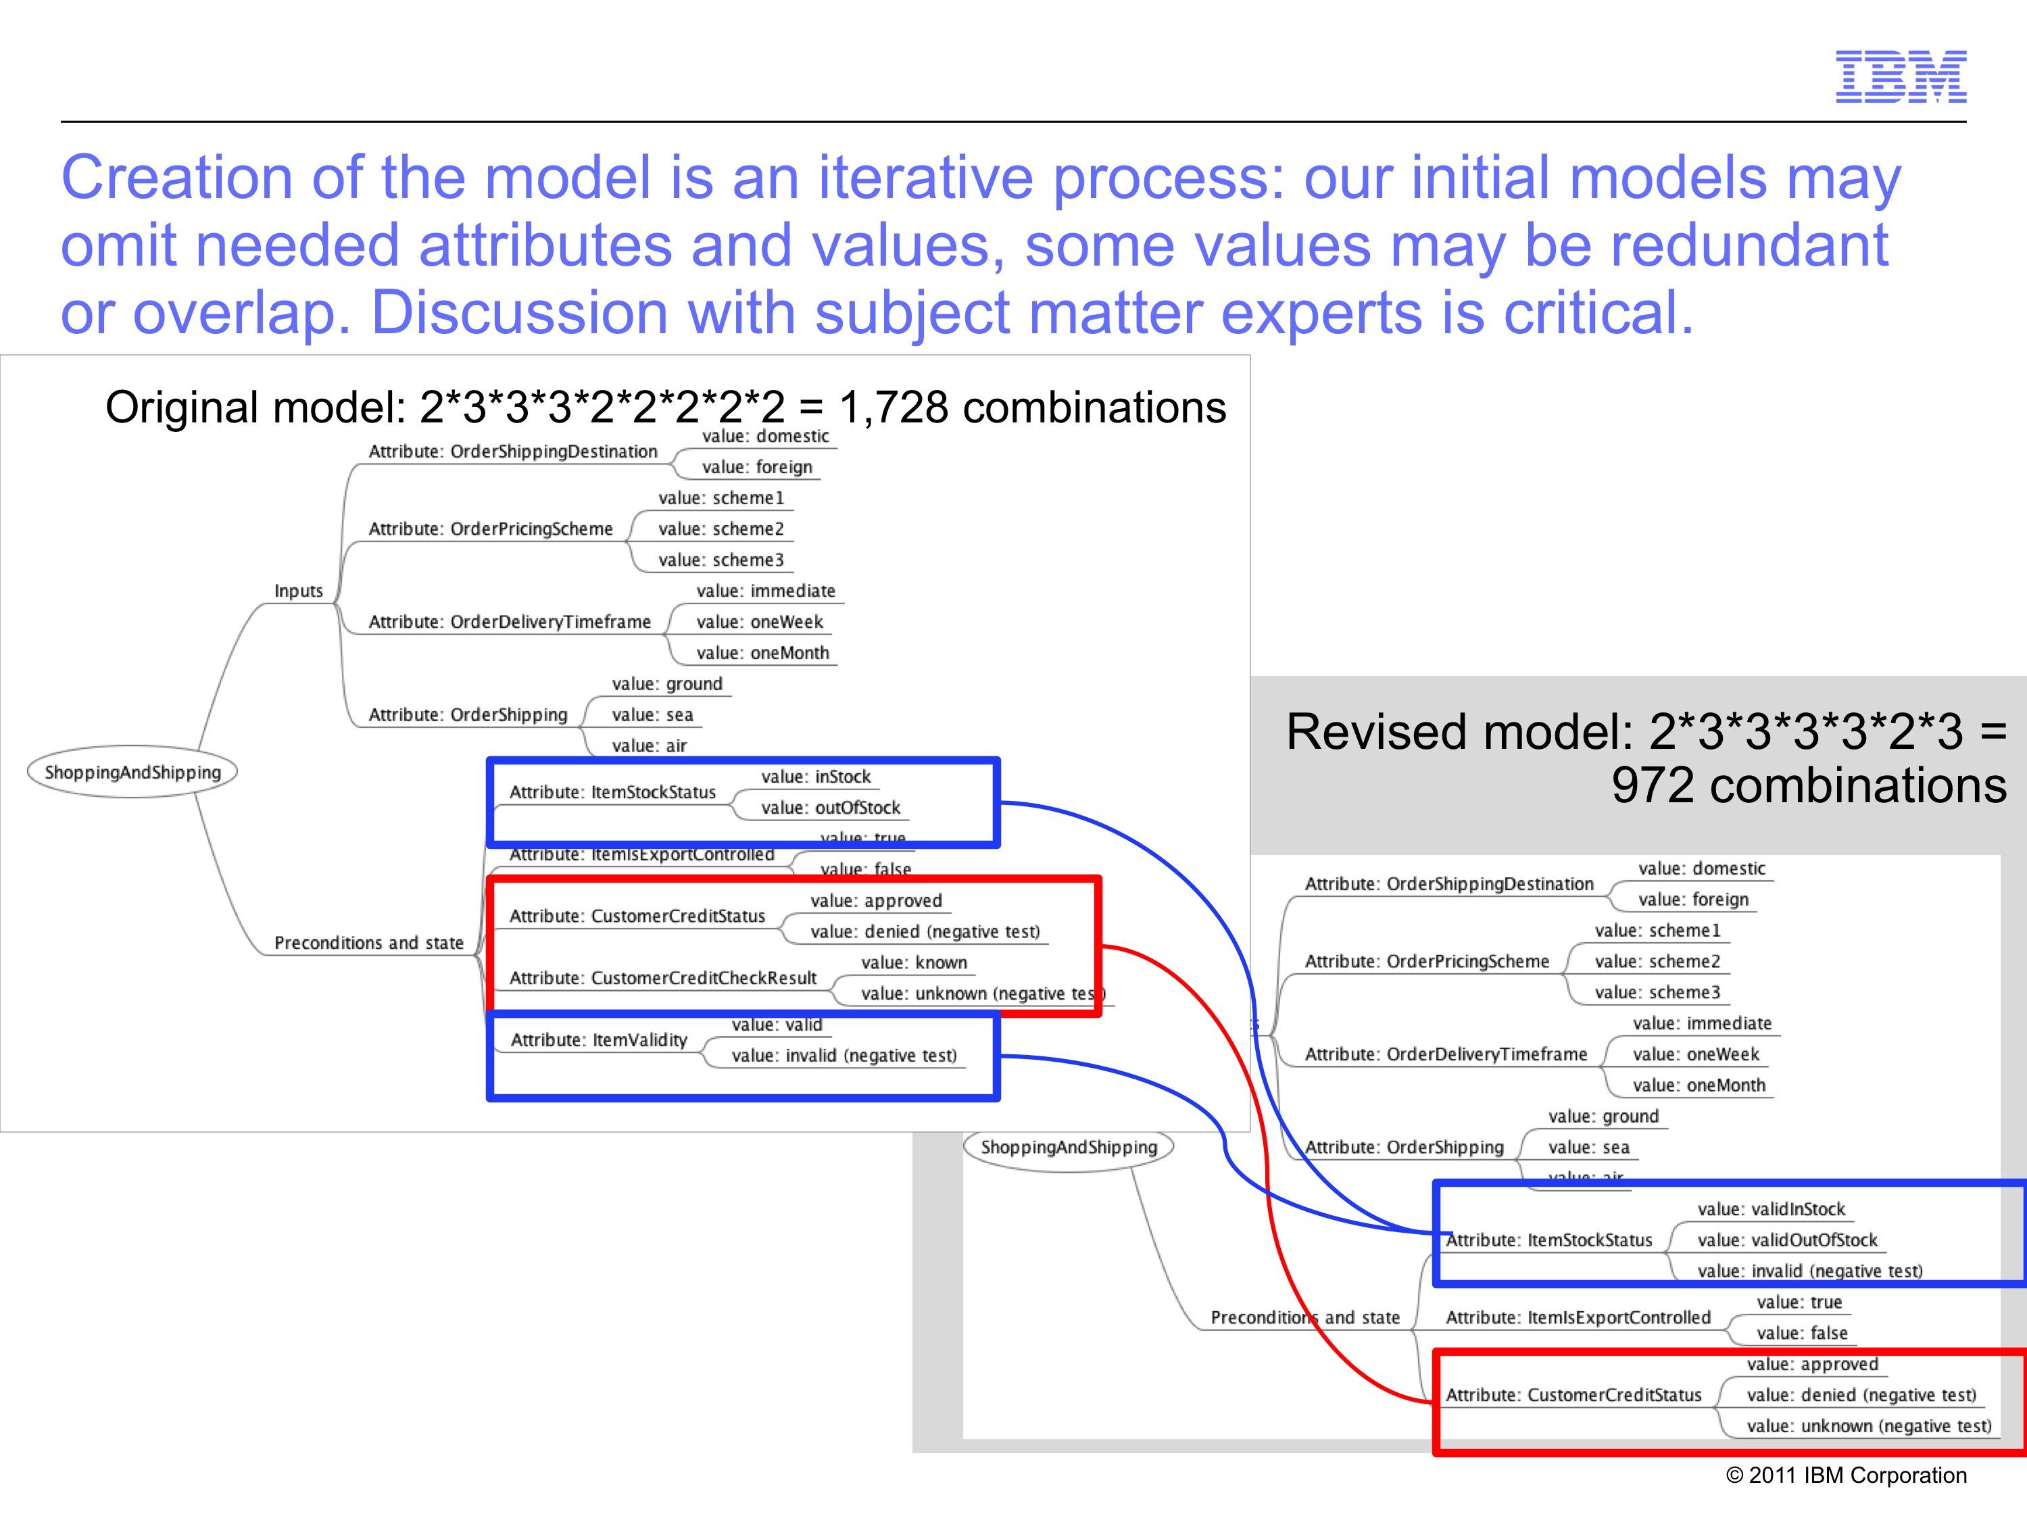
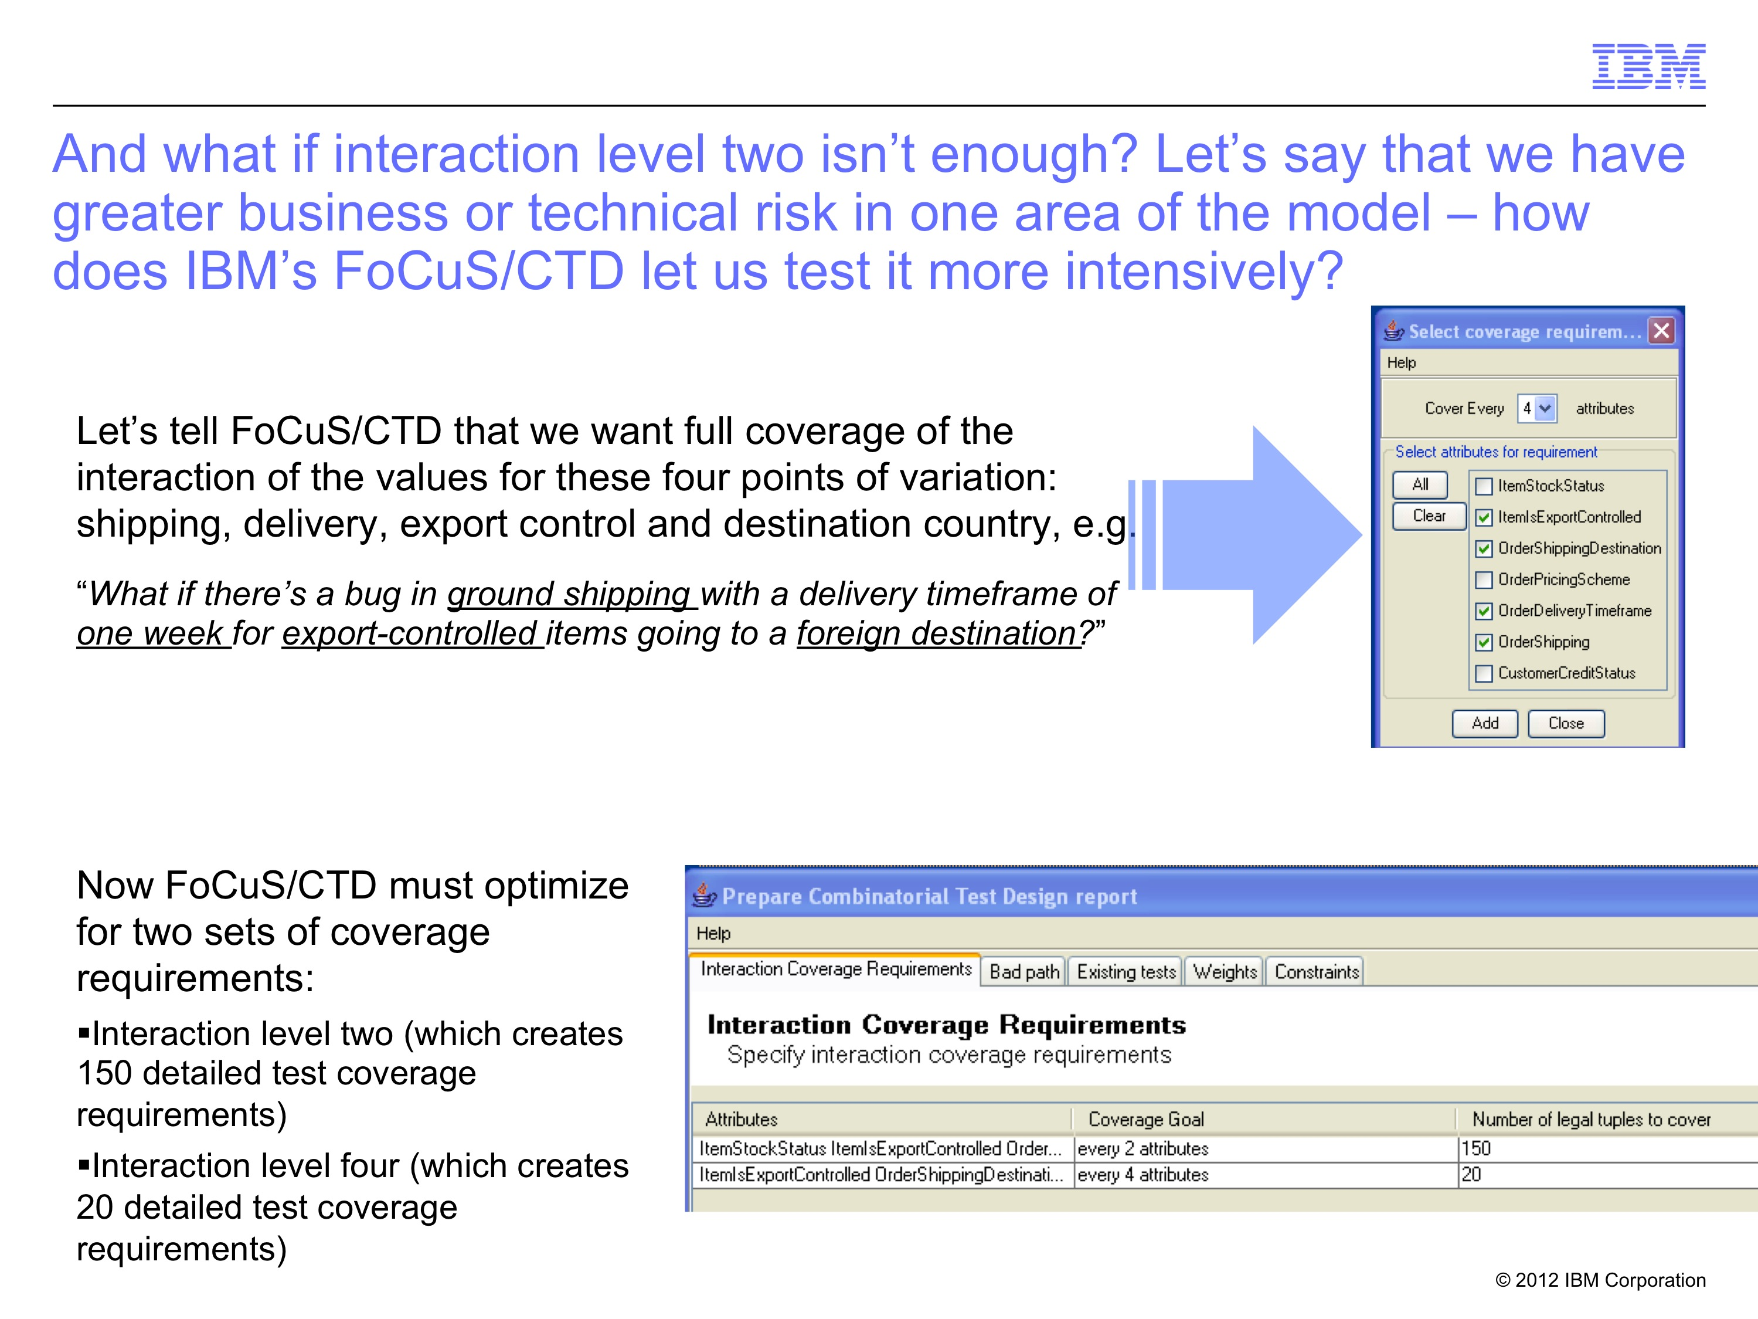
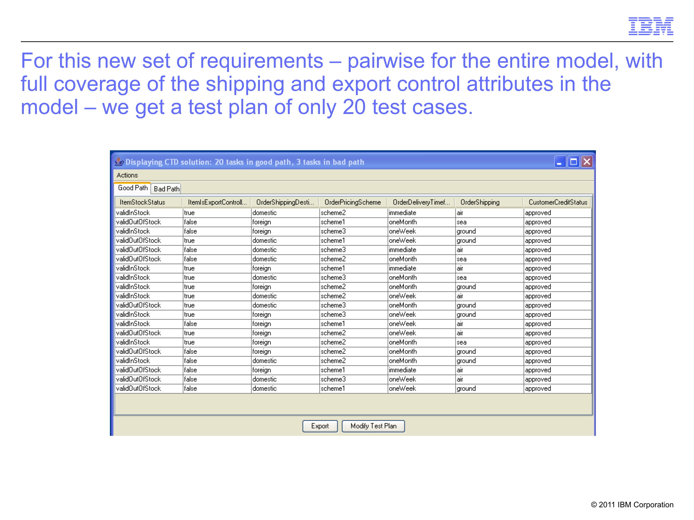
The four major steps in test planning using IBM's FoCuS / CTD:
2. Refine model
1. Create model
2. Refine model
3. Set intensity
4. Generate plan

Slide 10
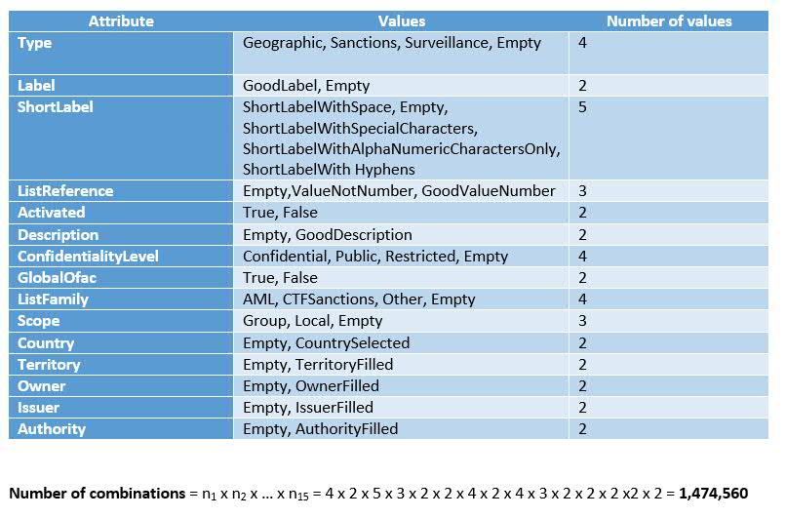
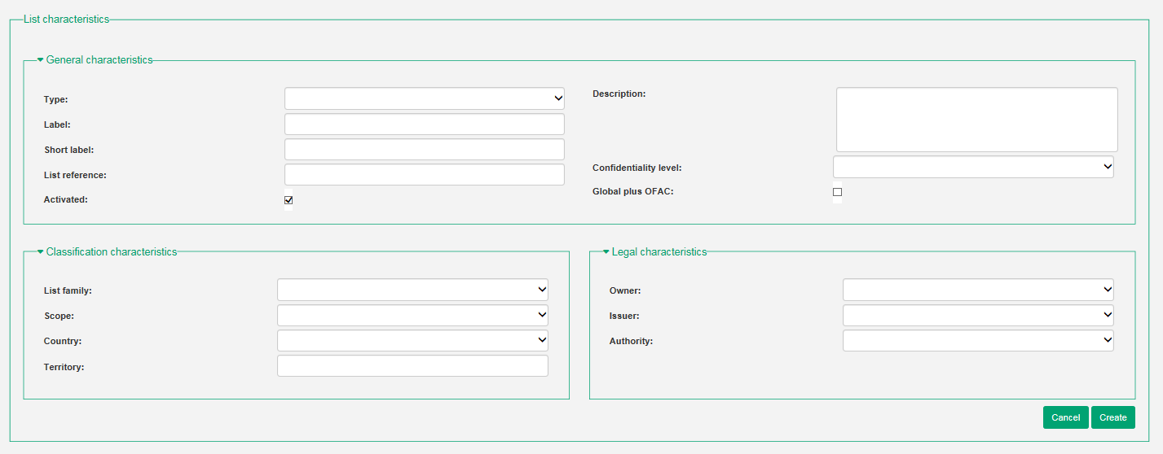
Requirement: FCU121 - Créer une liste/Create list
Screenshot application functionality

Slide 11
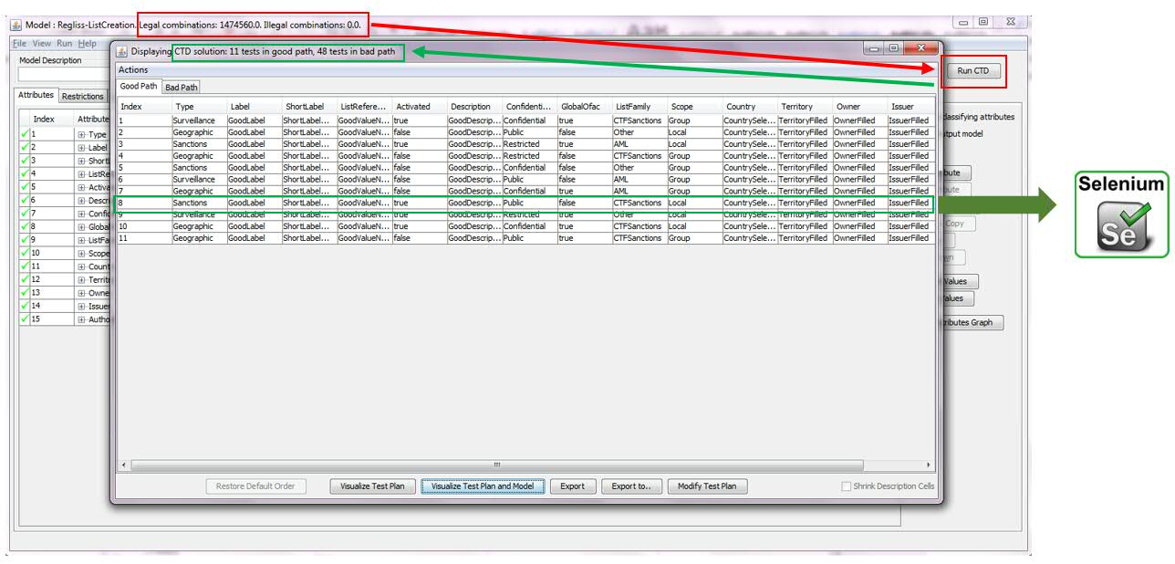
Test case: List creation – good path – CTD model
Test case: add a new list

Slide 12
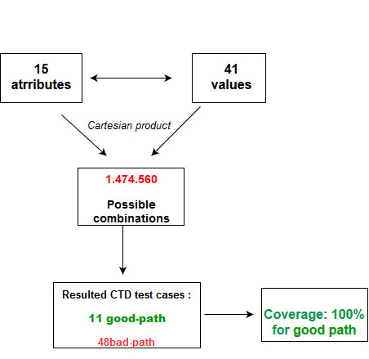
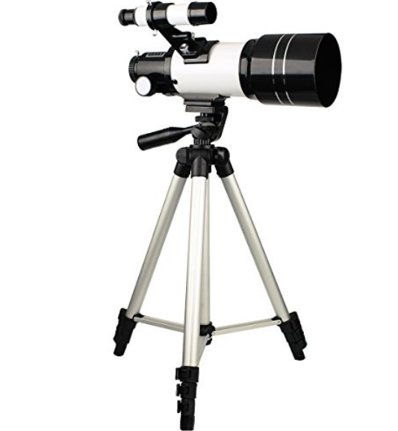
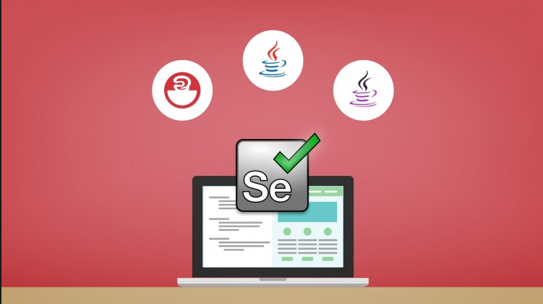
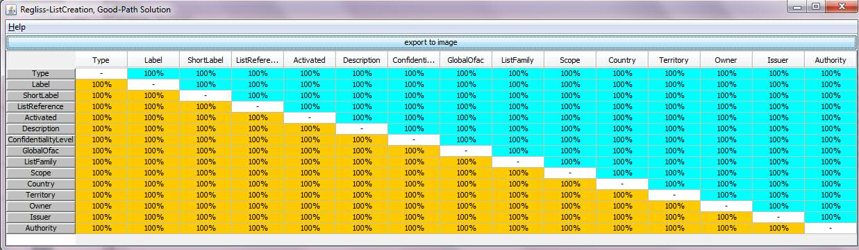
Test case: List creation – good path – coverage results
FOCUS
FOCUS

Slide 13
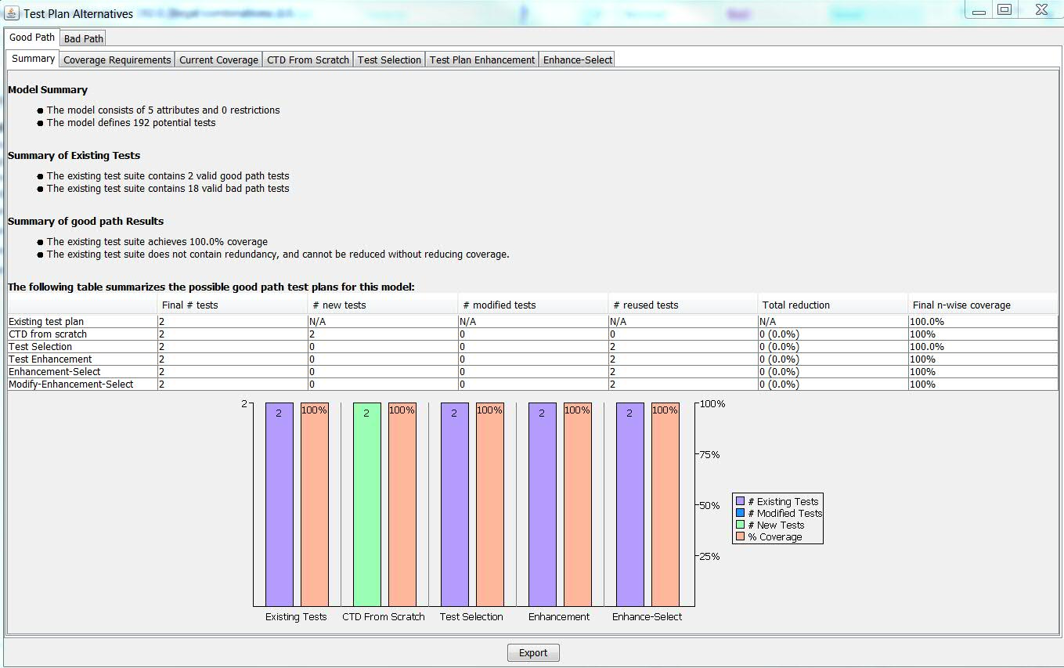
Test case: List creation – good path – coverage results

Slide 14
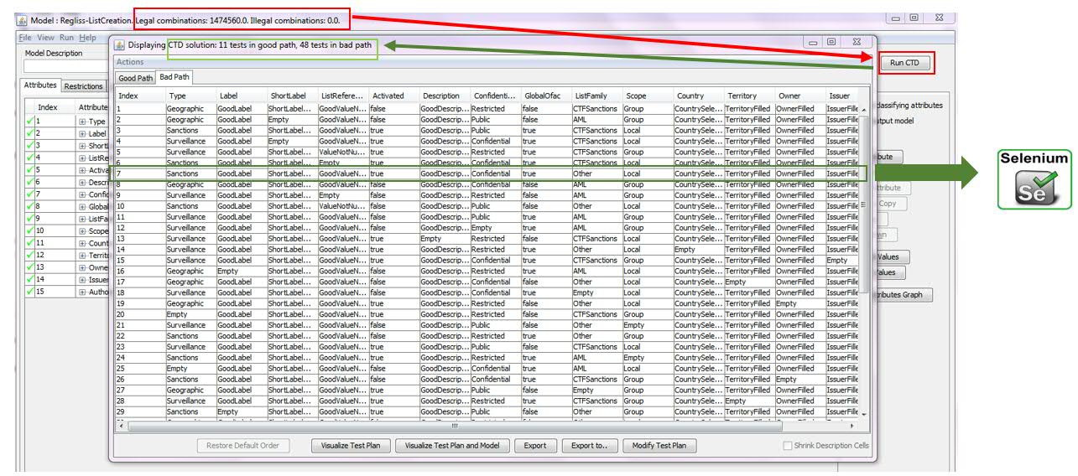
Test case: List creation – bad path – CTD model
Test case: incorrect input in the fields

Slide 15
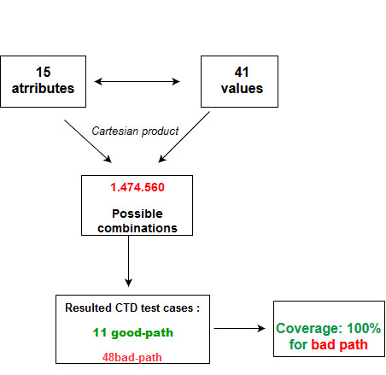
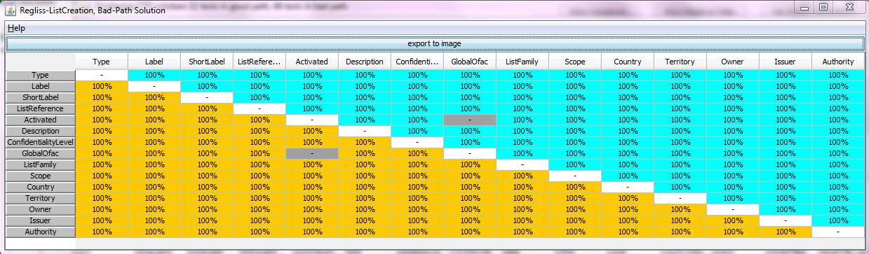
Test case: List creation – bad path – coverage results
FOCUS

Slide 16
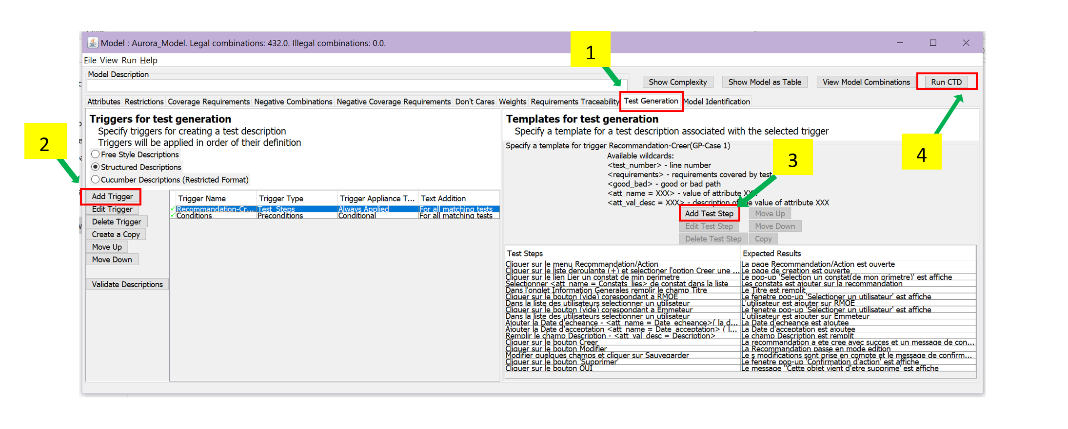
Test case: Create list – automatic import in ALM using Focus

Slide 17
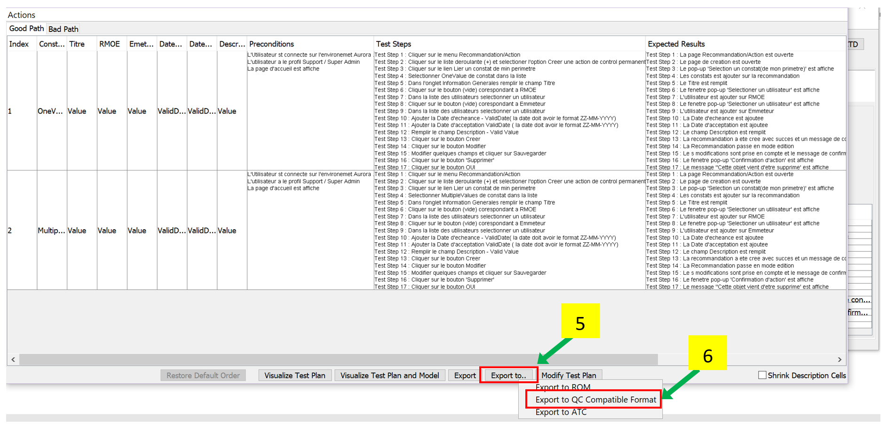
Test case: Create list – automatic import in ALM using Focus

Slide 18
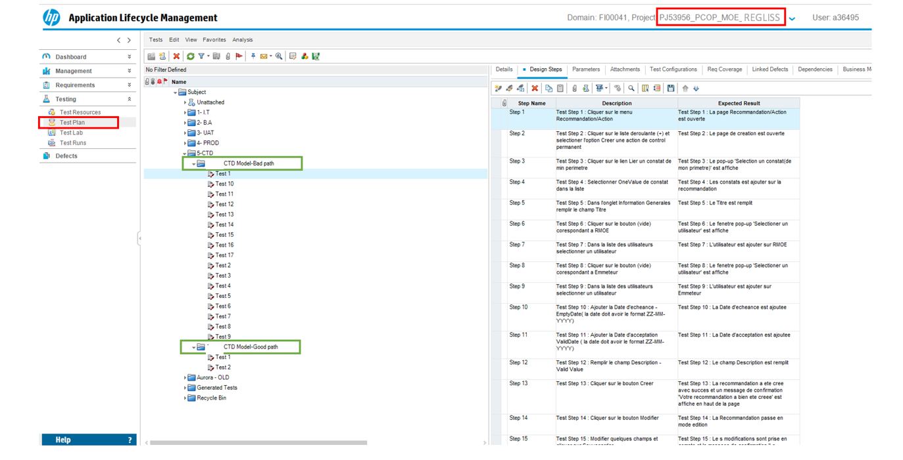
Test case: Create list – automatic import in ALM using Focus

Slide 19
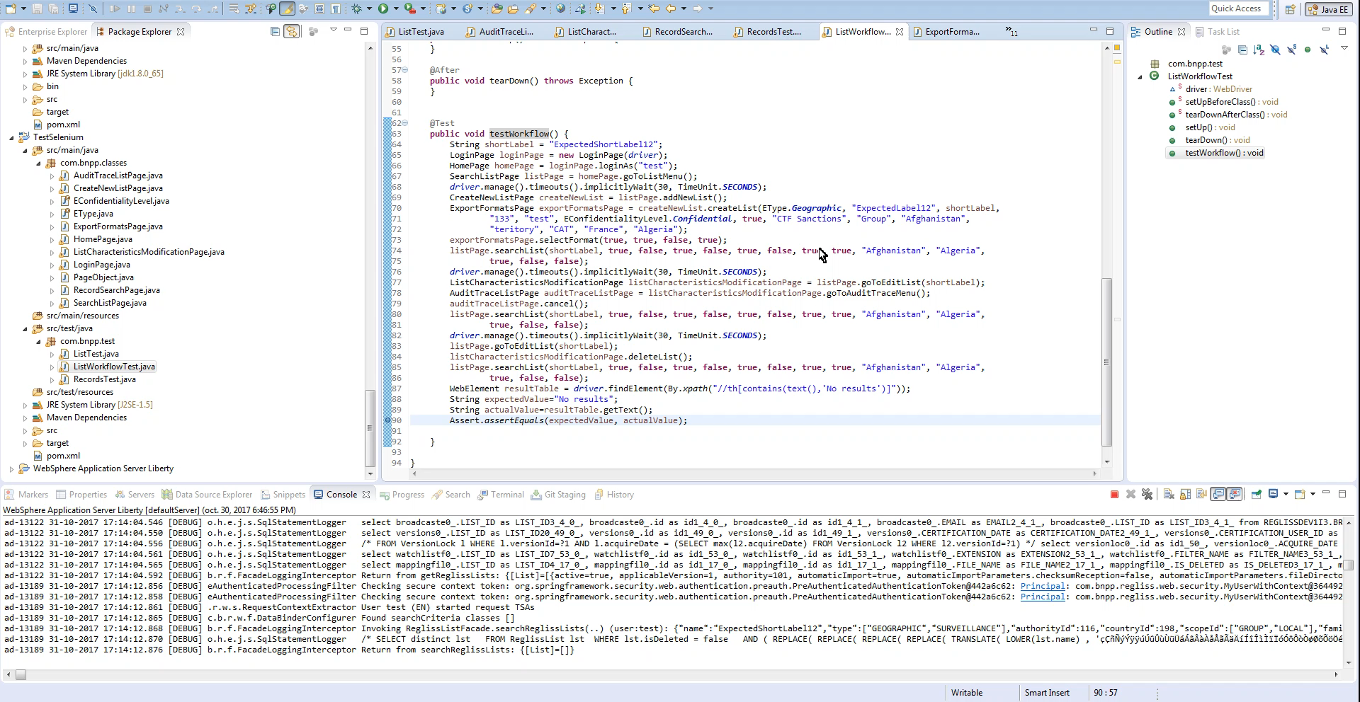
Run (TNR) E2E test for one complete and ☺ workflow ~12,5 seconds

Slide 20
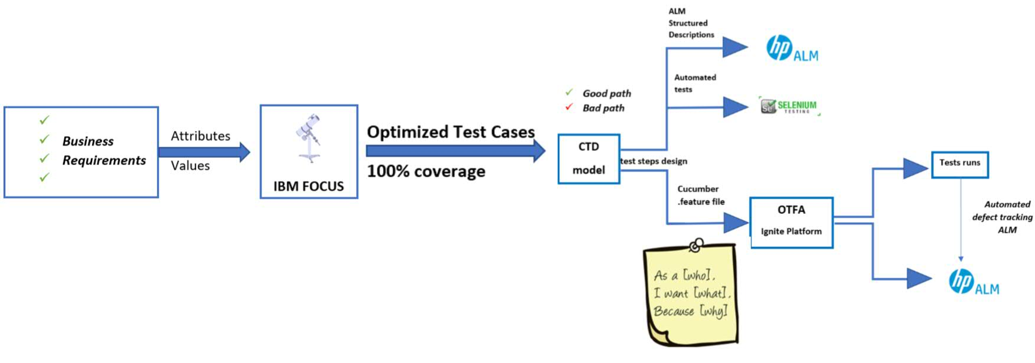
Future steps for the Pilot Automation
Automated workflow for Pilot

Slide 21
Pilot Optimized Test Flow Automation (OTFA)

Slide 22
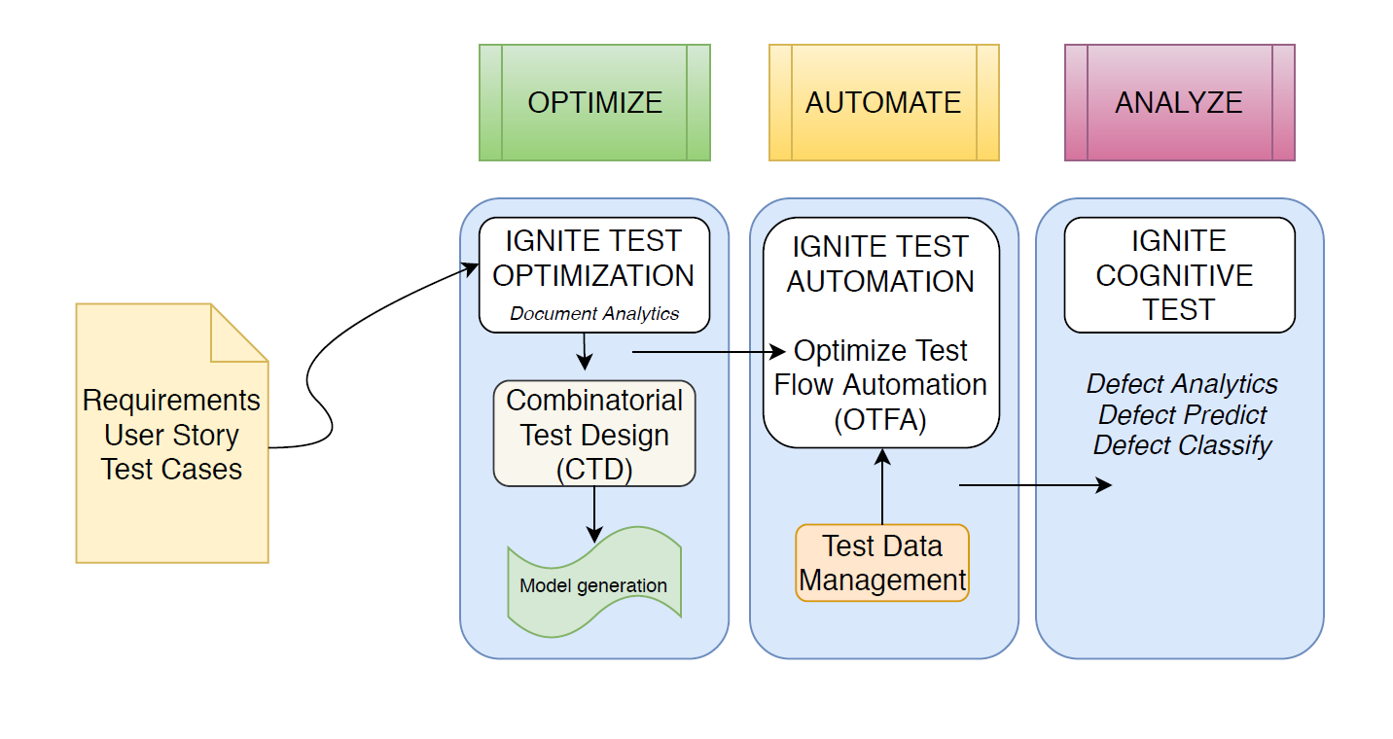
IGNITE PLATFORM MANAGEMENT
OTFA Overview

Slide 23
OTFA Overview
What is
Optimized Test Flow Automation (OTFA)?
Custom framework having Selenium incapsulated which allows the tester to run automated tests generated from CTD
Executes test cases and captures test results in the test result repository for each run
Generates reports for executed test cases (including screenshots for each test and image comparison)
Logs test case results and defects directly into defect management tools (ALM)
AUTOMATION and OPTIMIZATION
It supports a range of browsers like IE, Edge, Mozilla Firefox and multiple OS
It supports integration with Test Management Tools, Jenkins Automated Build
Does not need programming skills for the tester
Why
Optimized Test Flow Automation (OTFA)?
Value Proposition
reduces the test execution time
minimizes the costs for planning, design, execution and reporting phases in testing lifecycle
improves quality
better visibility and transparency in the testing process

Slide 24
OTFA – One tool to rule them all
Covers:
Object and data mapping
Executions of test cases
Storage of test results into the result repository
Reports generations for the executed tests
Image comparison
Scripts’ re-usage
Logging of the defects
Uploading of the tests’ cases
Tests Runs(Fail/Pass)
Integrates with:
Test Management Tools (HP ALM, JIRA)
Reporting Engines
Version Control Repository
Jenkins Automated Build
Automates:
Selenium
Appium
Perfecto
Rest
Soap UI
Commercial

Slide 25
Process Overview

Slide 26
Major steps in OTFA
Upload feature file
Create CTD model
Generate cucumber feature file
Automatic creation of the test plan ALM
2. Map objects
Browser plug-in
Object locators & prioritisation
Map existing object (if there is another test using the object)
3. Set up data
Create Excel file with data set for each test (values used)
Upload
Map objects to the column
4. Set up execution details
Mode parallel
sequential
Run on browser
server
Browser selection
Selenium hub choice
Homepage URL
5. Start test
Run test cases
Mode parallel
sequential
6. View Report
In OTFA Test details
Screenshots
Defects log
Test run records
Defects log

Slide 27


Robotic Process Automation
IBM Blueprism

Slide 28
RPA – Blue Prism
BP vs other RPA tools
Enterprise Automations
Leading UI based automation tool
Very good task orchestration capabilities
Can work from IBM Cloud

Slide 29
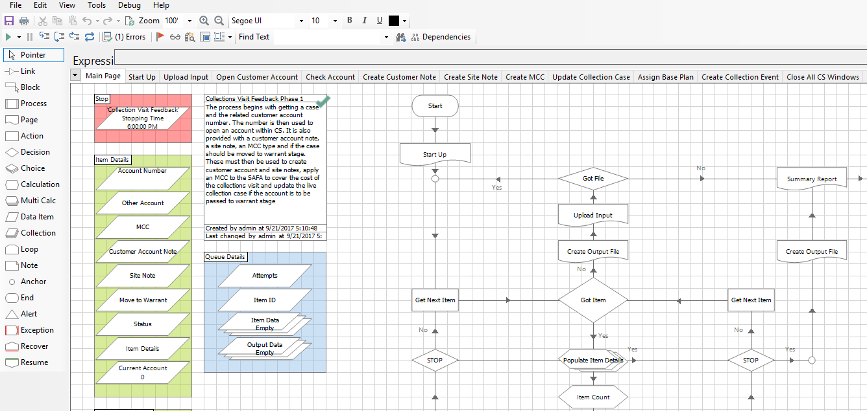
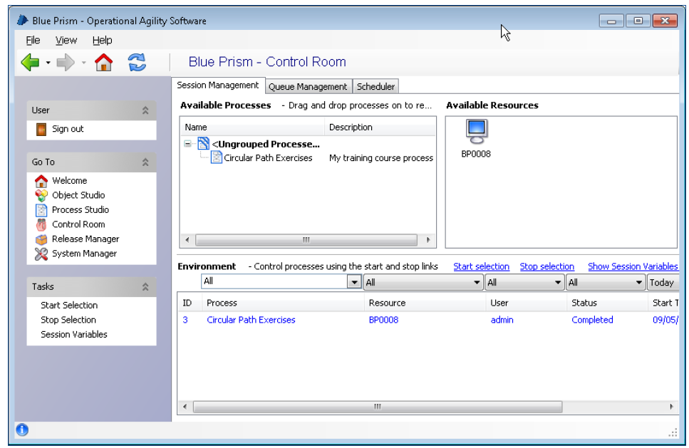

BP high-level overview
RPA – Blue Prism
Robot (Automation Workflow)
Robot management - Control Room
Client stations – Virtual Workforce

Slide 30
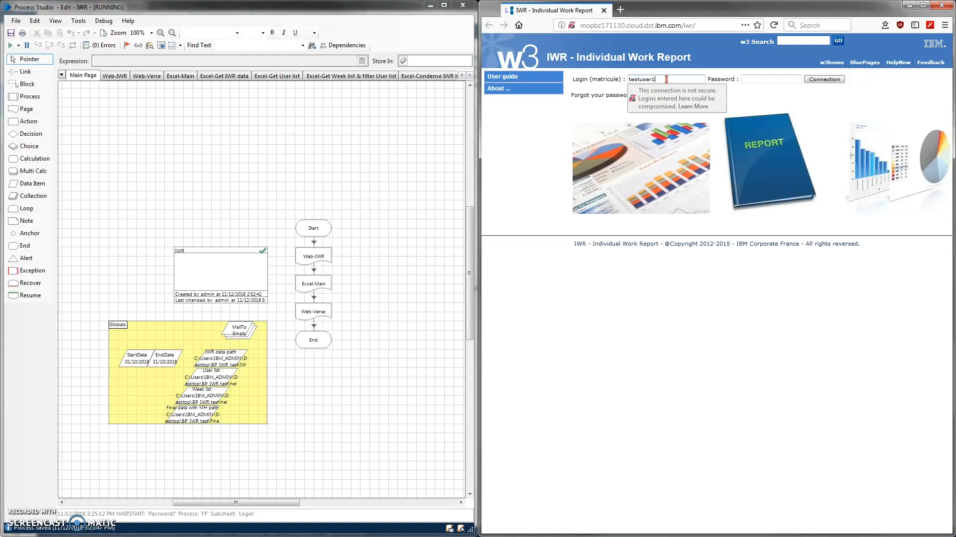

Slide 31


